Slide 1
Contact Management System
.Net project
Presented By:
Md. Amanullha (173014040)
Sumit Chakraborty (173014014)
Md. Rahimuzzaman Bhuiyan (173014041)

Slide 2
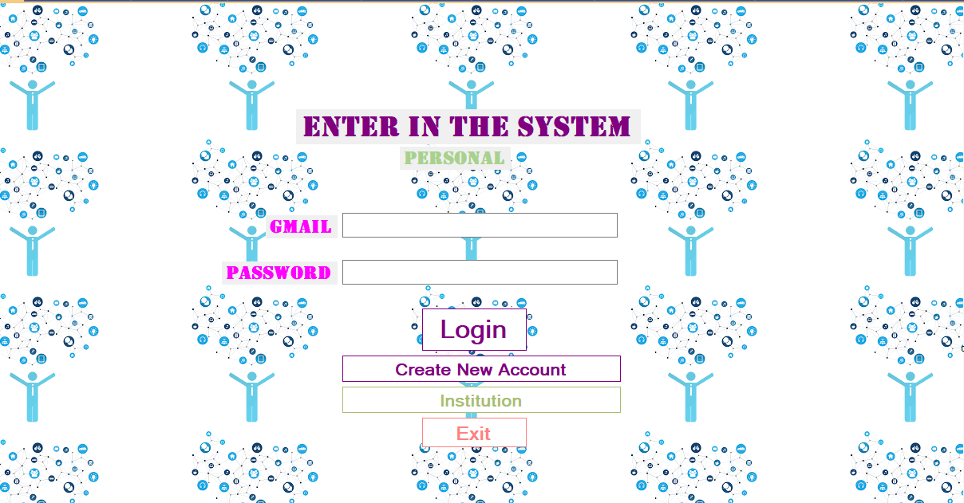
Introduction
Features:
Storing, searching and messaging users
Creating a contact book for an educational institution
Storing categorized information of faculties and students

Slide 3
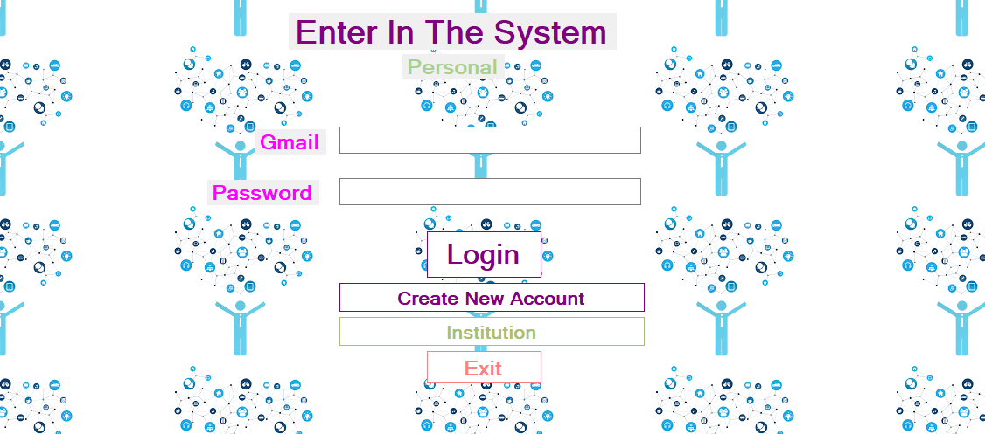
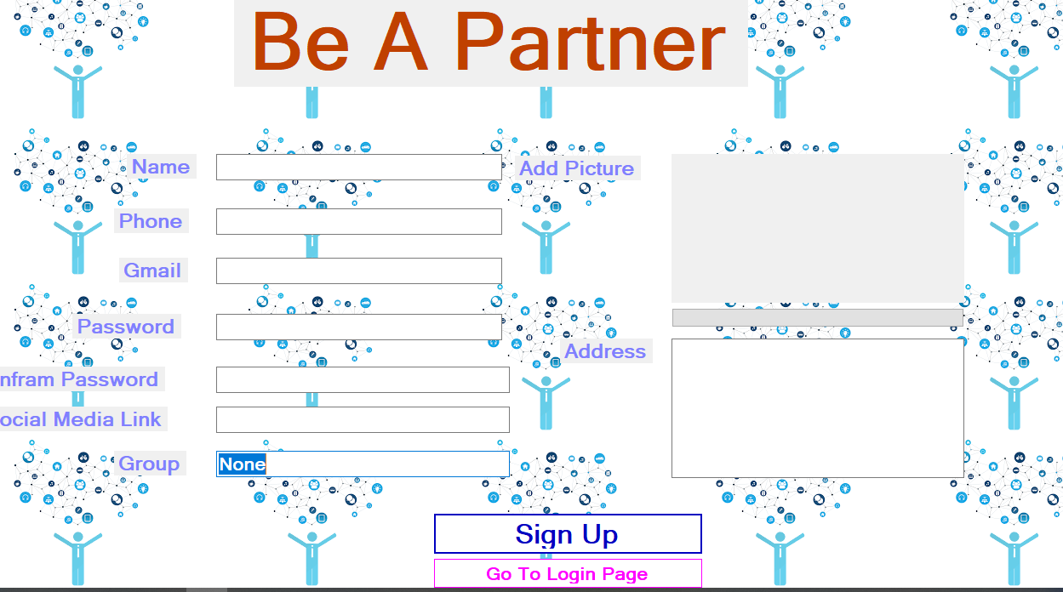
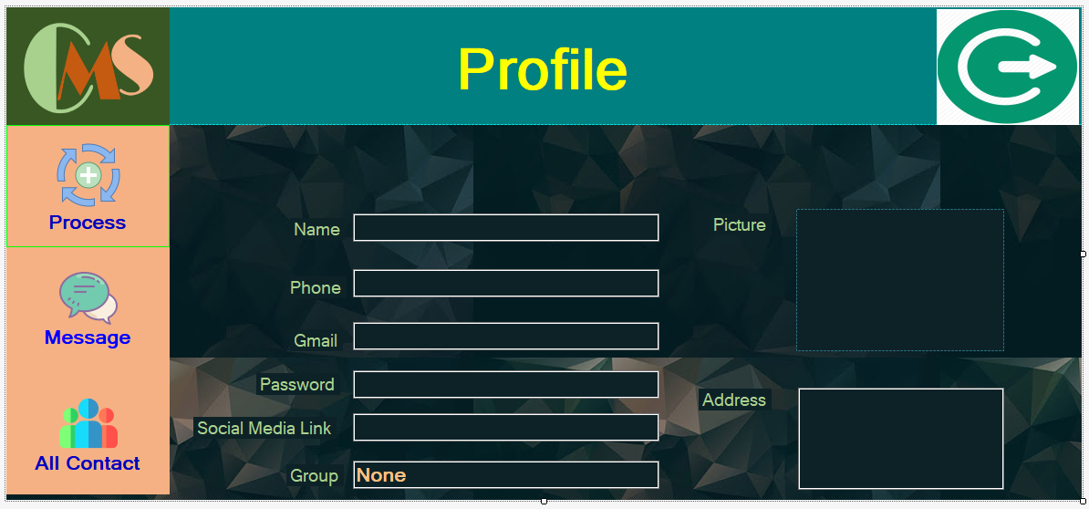
Login and Registration

Slide 4
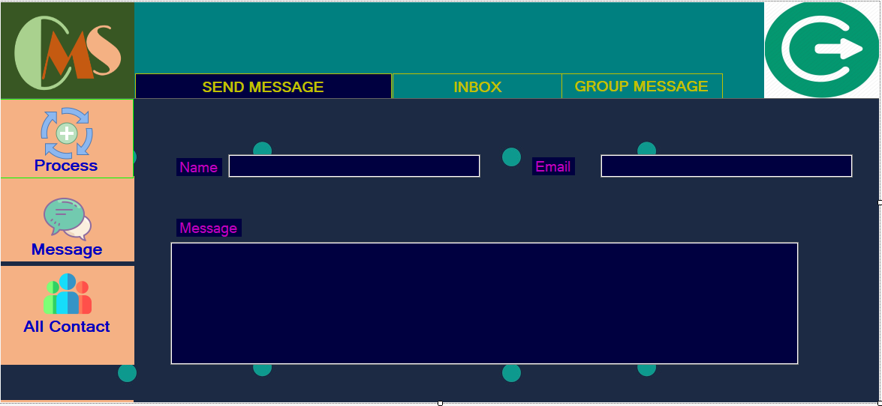
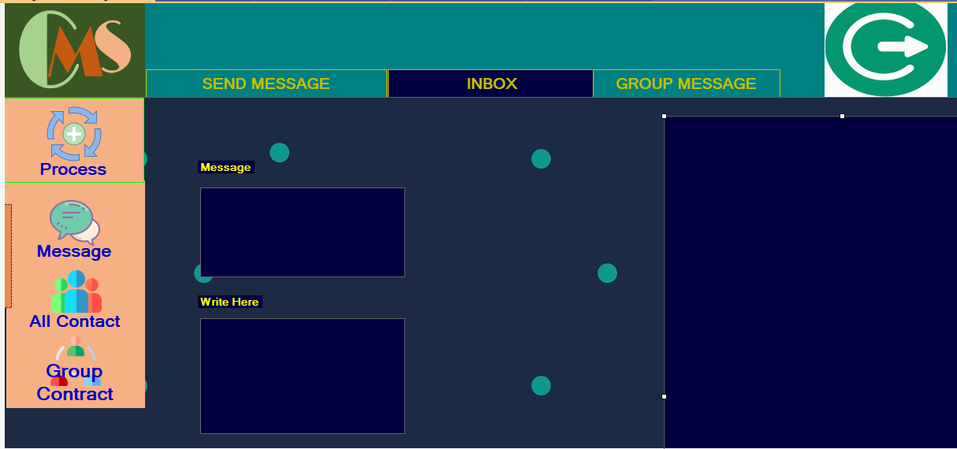
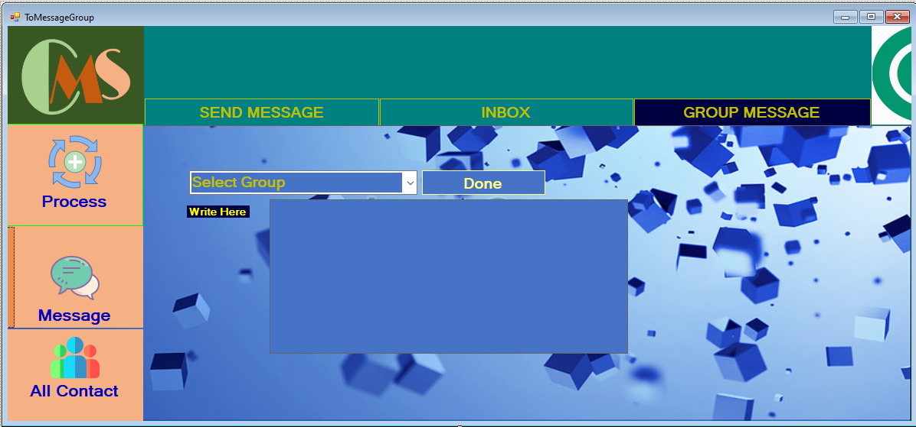
Messaging

Slide 5
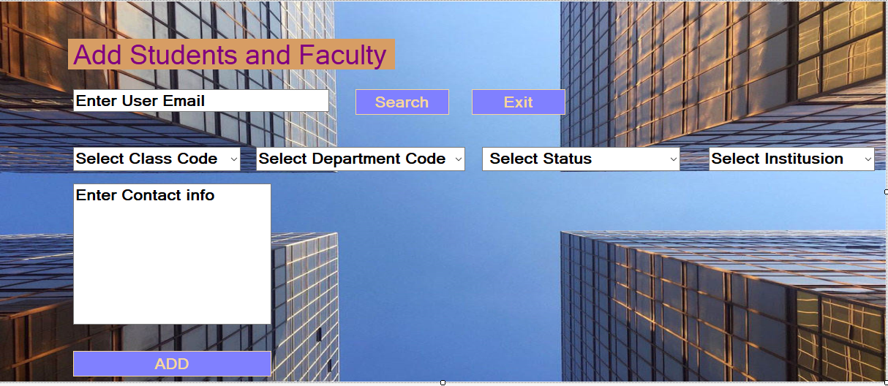
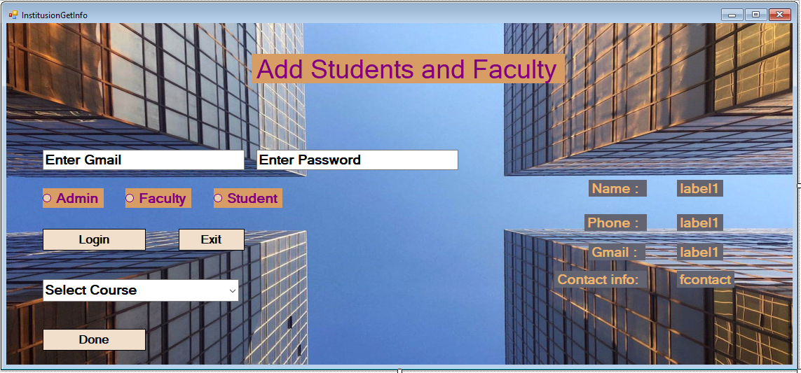
Adding Institutions

Slide 6
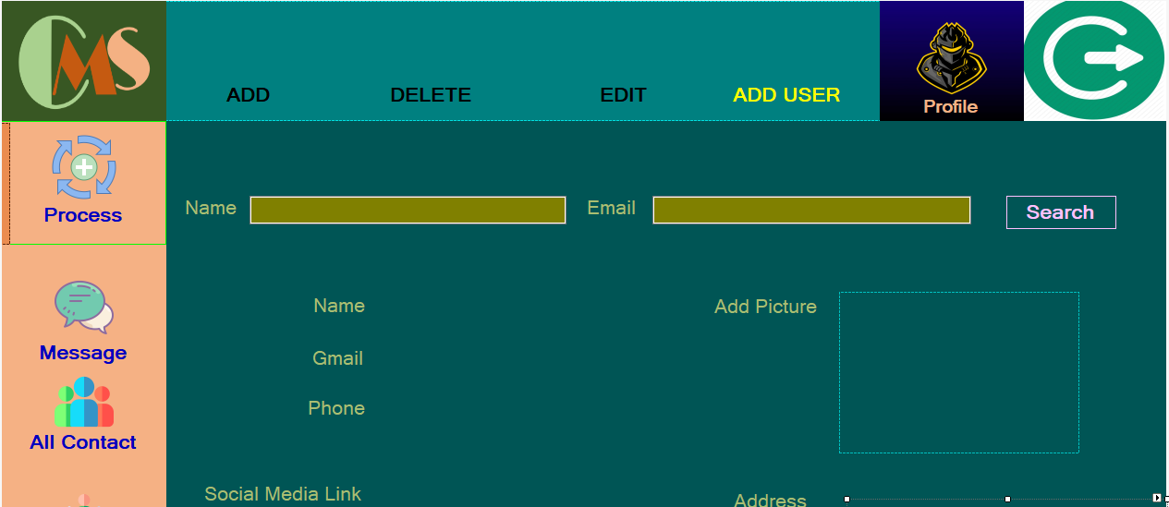
Add, Update and Delete Contacts

Slide 7
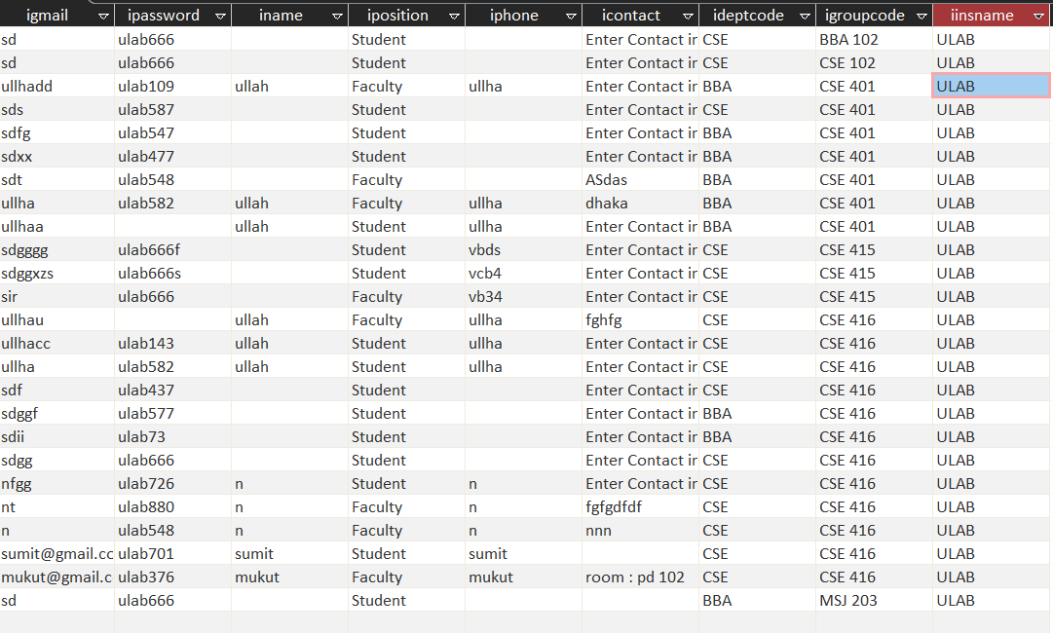
institution

Slide 8
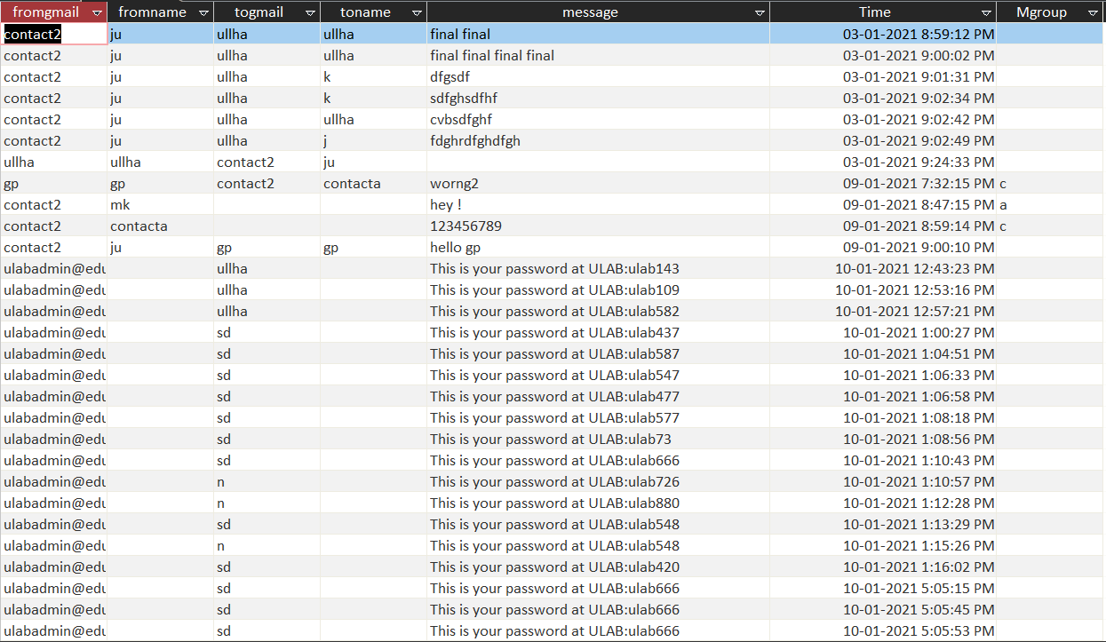
Messages

Slide 9
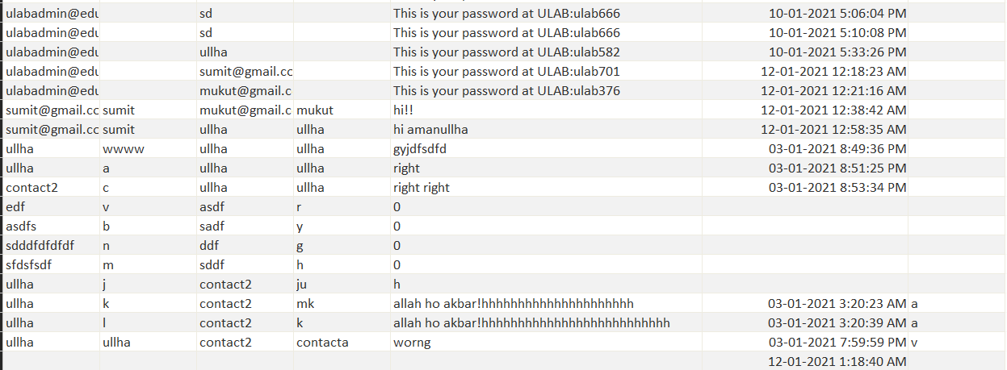
Messages

Slide 10
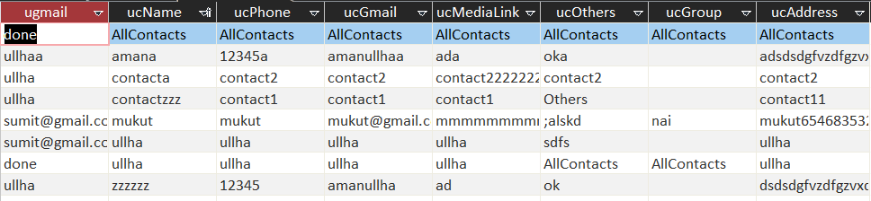
User contact

Slide 11
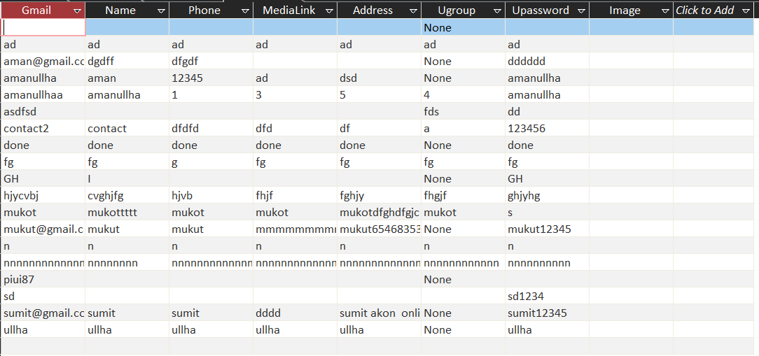
User table

Slide 12
Implementation
Basic
Login()
Registration()
Institution
3. InstitutionGetInfo()
4. InstitutionInsert()
Individual
3. Dashboard()
4. Process() 5. Message() 6. AllContact() 7. GroupContact()
ProcessAddContact()
ProcessAddUser()
ProcessEditUser()
ProcessDeleteUser()
Show all Contact
DeleteUser()
EditUser()
Show all Group
RemoveFromTheGroup()
ShiftToOtherGroup()
ToMessage()
ToMessageInbox()
ToMessageGroup()

Slide 13
Query
Database Connection : OleDbConnection conn = new OleDbConnection(@"Provider=Microsoft.ACE.OLEDB.12.0;Data Source=C:\Users\User\Desktop\C#\Fp\CMS.accdb;Persist Security Info=False;");
Insert Data : command.CommandText = "insert into Messages(fromgmail,fromname,togmail,toname,message)values('" + from + "','" + fname + "','" + to + "','" + tname + "','" + message + "')";
Update Data : "UPDATE UserTable SET Name='" + nameb.Text + "',Phone='" + phoneb.Text + "',MediaLink='" + medialinkb.Text + "',Address='" + addressb.Text + "',Ugroup='" + groupb.Text + "', Upassword='" + Passwordb.Text + "' where Gmail='" + currentuser + "'";
Delete Date : "delete from UserContact where ugmail= '" + currentuser + "'and ucName='" + dnt + "' and ucGmail='" + dgt + "'";
Search Data : "select * from UserTable where Gmail='" + gmailt.Text + "'and Upassword='" + passwordt.Text + "'"; OleDbDataReader reader = command.ExecuteReader();
Show Data with Gridview: OleDbDataAdapter da = new OleDbDataAdapter(cmd); da.Fill(dt); dataGridView1.DataSource = dt;
Read Data From Gridview : dataGridView1.DataSource = dt; dataGridView1.Columns["ucName"].HeaderText = "Name";

Slide 14
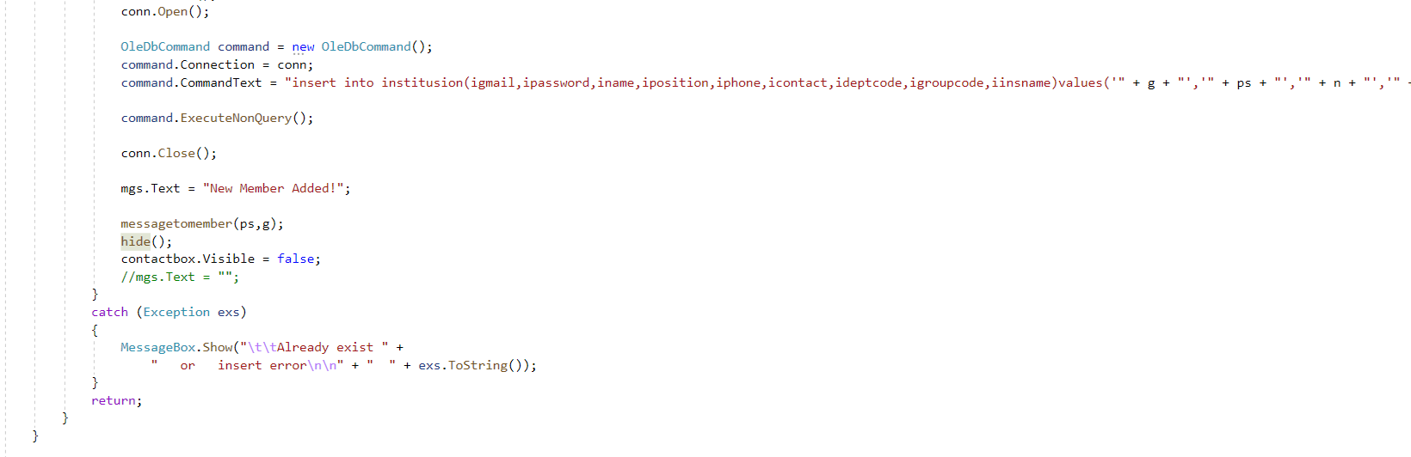
INSERT DATA

Slide 15
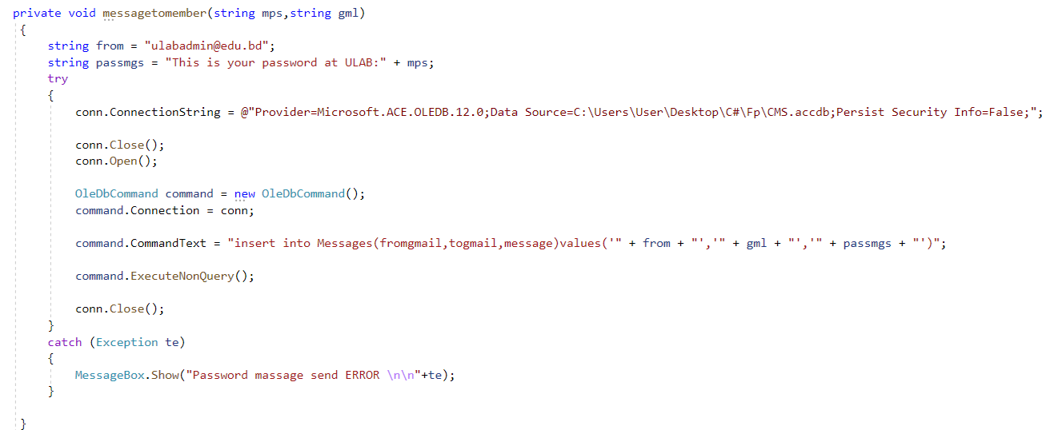
Send Message to the Students after Added a classroom

Slide 16
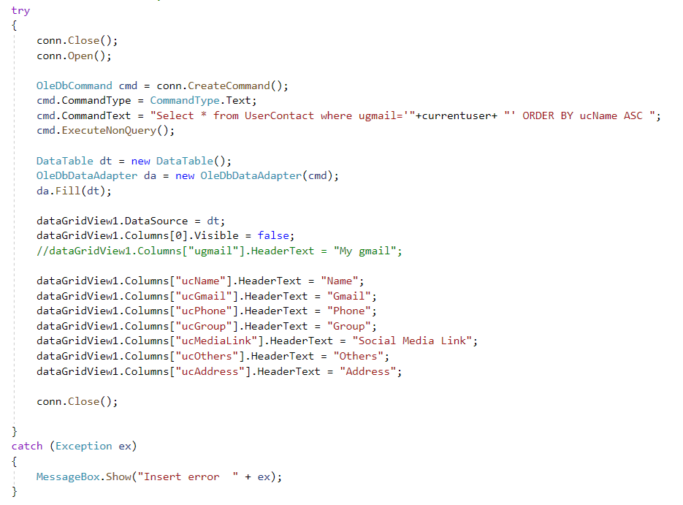
Show All Contact

Slide 17
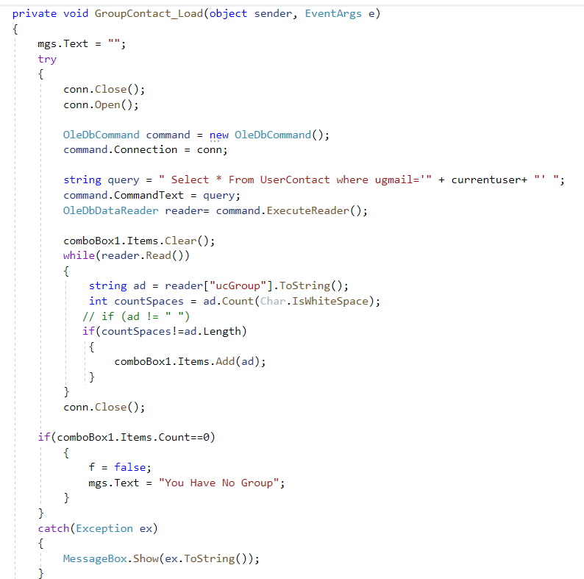
Show All Group

Slide 18
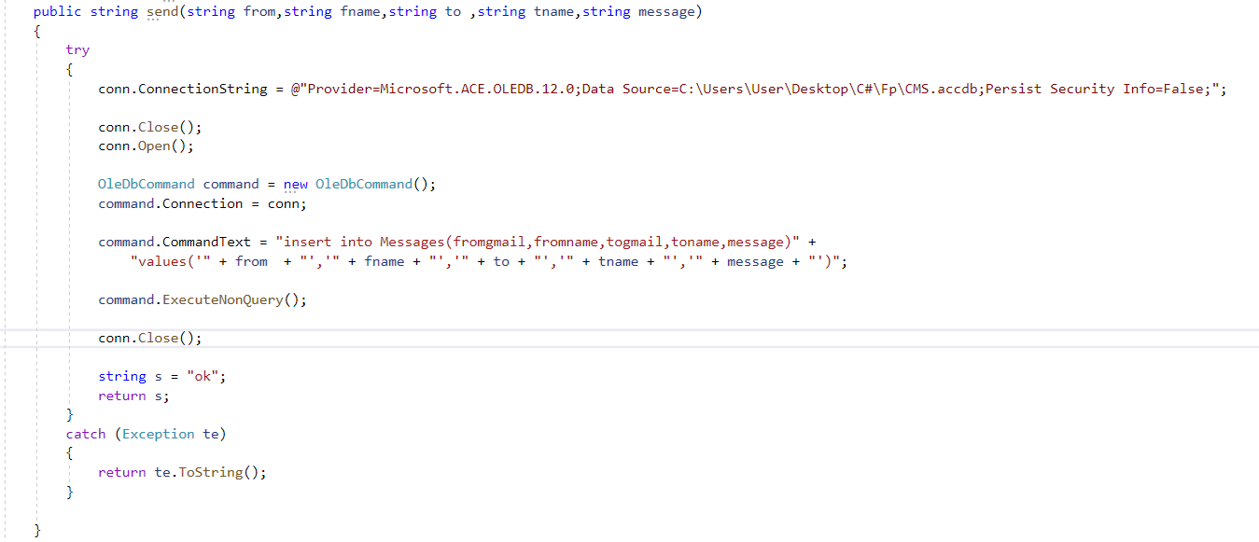
Send Message

